Slide 1

Design Session: Theme Generator
POWER PLATFORM

Slide 2


Mitch Milam
mitch@xrmcoaches.com
@mitchmilam
linkedin.com/in/mitchmilam
youtube.com/xRMCoaches

Slide 3
Dynamics 365 Training
http://learn.xrmcoaches.com
JavaScript Training
Free and Paid courses

Slide 4
App Design Course
https://learn.xrmcoaches.com/courses/appdesign
Officially opens on: 2 March 2020
Introductory pricing of $97
After 2 March, the normal price will be $197

Slide 5
Next Webinar
The Art and Science of Model-Driven App Design

Slide 6
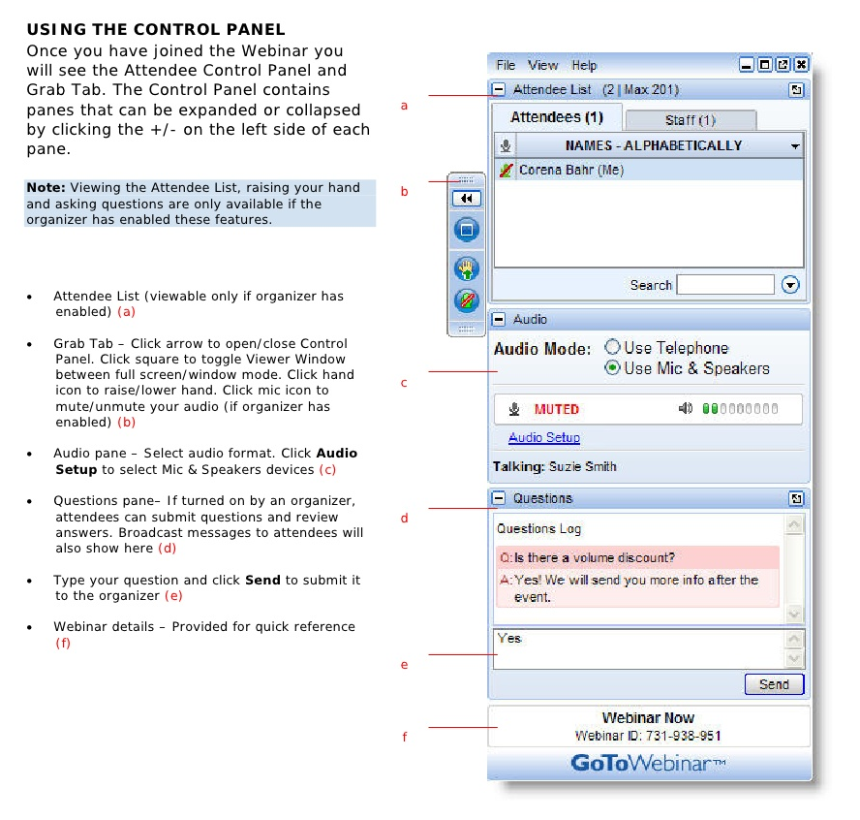
Webinar Housekeeping

Slide 7
Design Goals
…

Slide 8
Design Goals
Replace the Built-In Theme configuration tool
Utilize UCI interface
PCF Color-Picker component
Push data back to built-in Theme entity

Slide 9
Iterations
Basic functionality
Enhanced functionality
Full Replacement for built-in Themes

Slide 10
Iteration 1
Allow users to select colors
Save/update the colors to an associated Theme record

Slide 11
Iteration 2
Clone existing Theme record
Allow selection of Logo web resource

Slide 12
Iteration 3
Modify selected Built-In Theme
Save/Publish Custom Theme to Built-In Theme

Slide 13
Technical Hurdles
…

Slide 14
Built-In Themes
Not customizable
Only works on Web interface
Manually intensive
Definition is protected

Slide 15
Toolbox
…

Slide 16
XrmToolbox
Metadata browser
FetchXml Builder

Slide 17
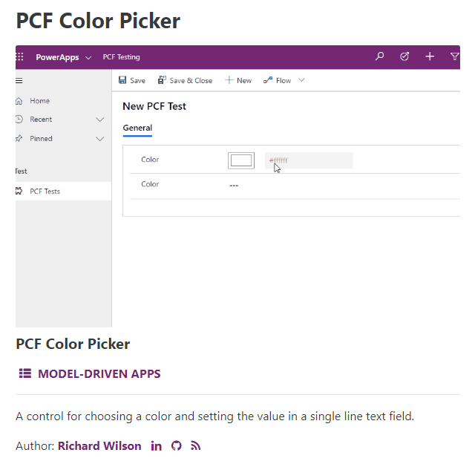
PCF Color Picker

Slide 18
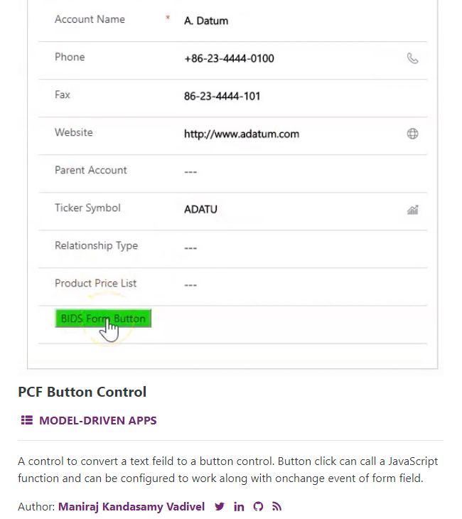
PCF Button Control

Slide 19
Entity Creation
A lesson in reverse-engineering

Slide 20
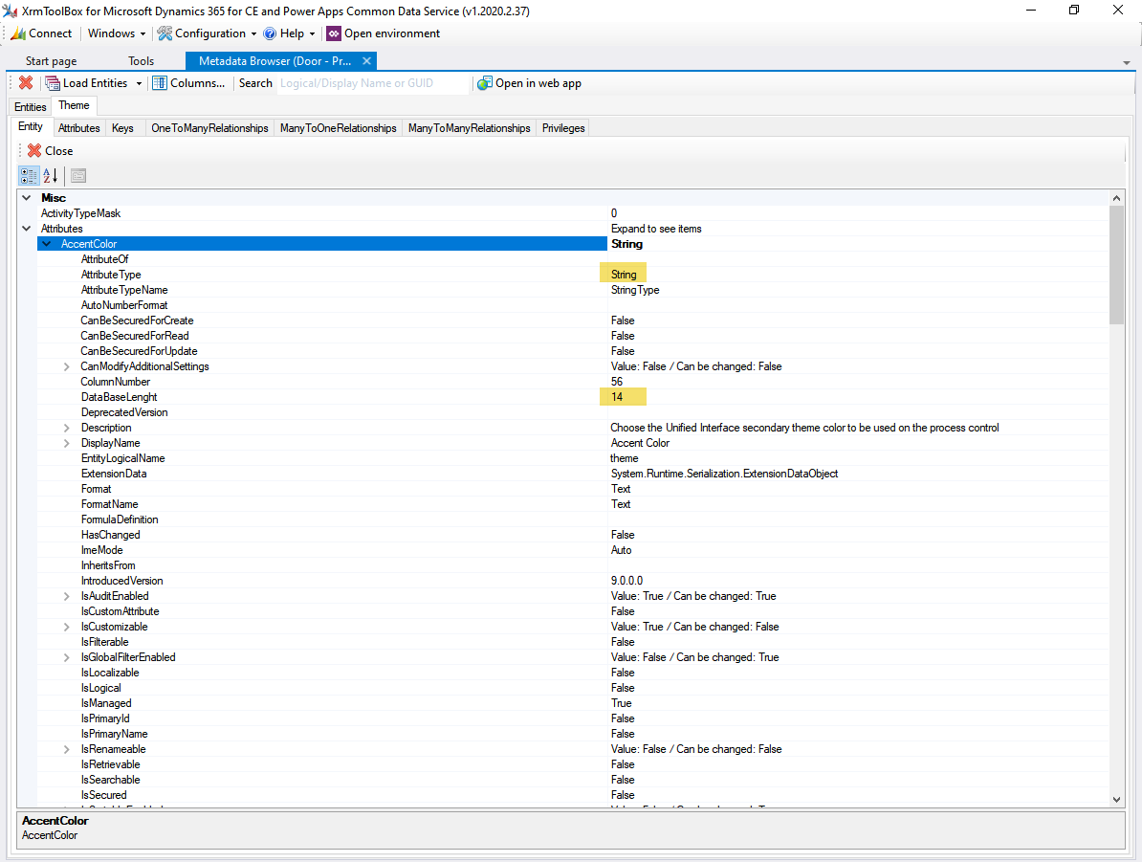
XrmToolbox Metadata Browser

Slide 21
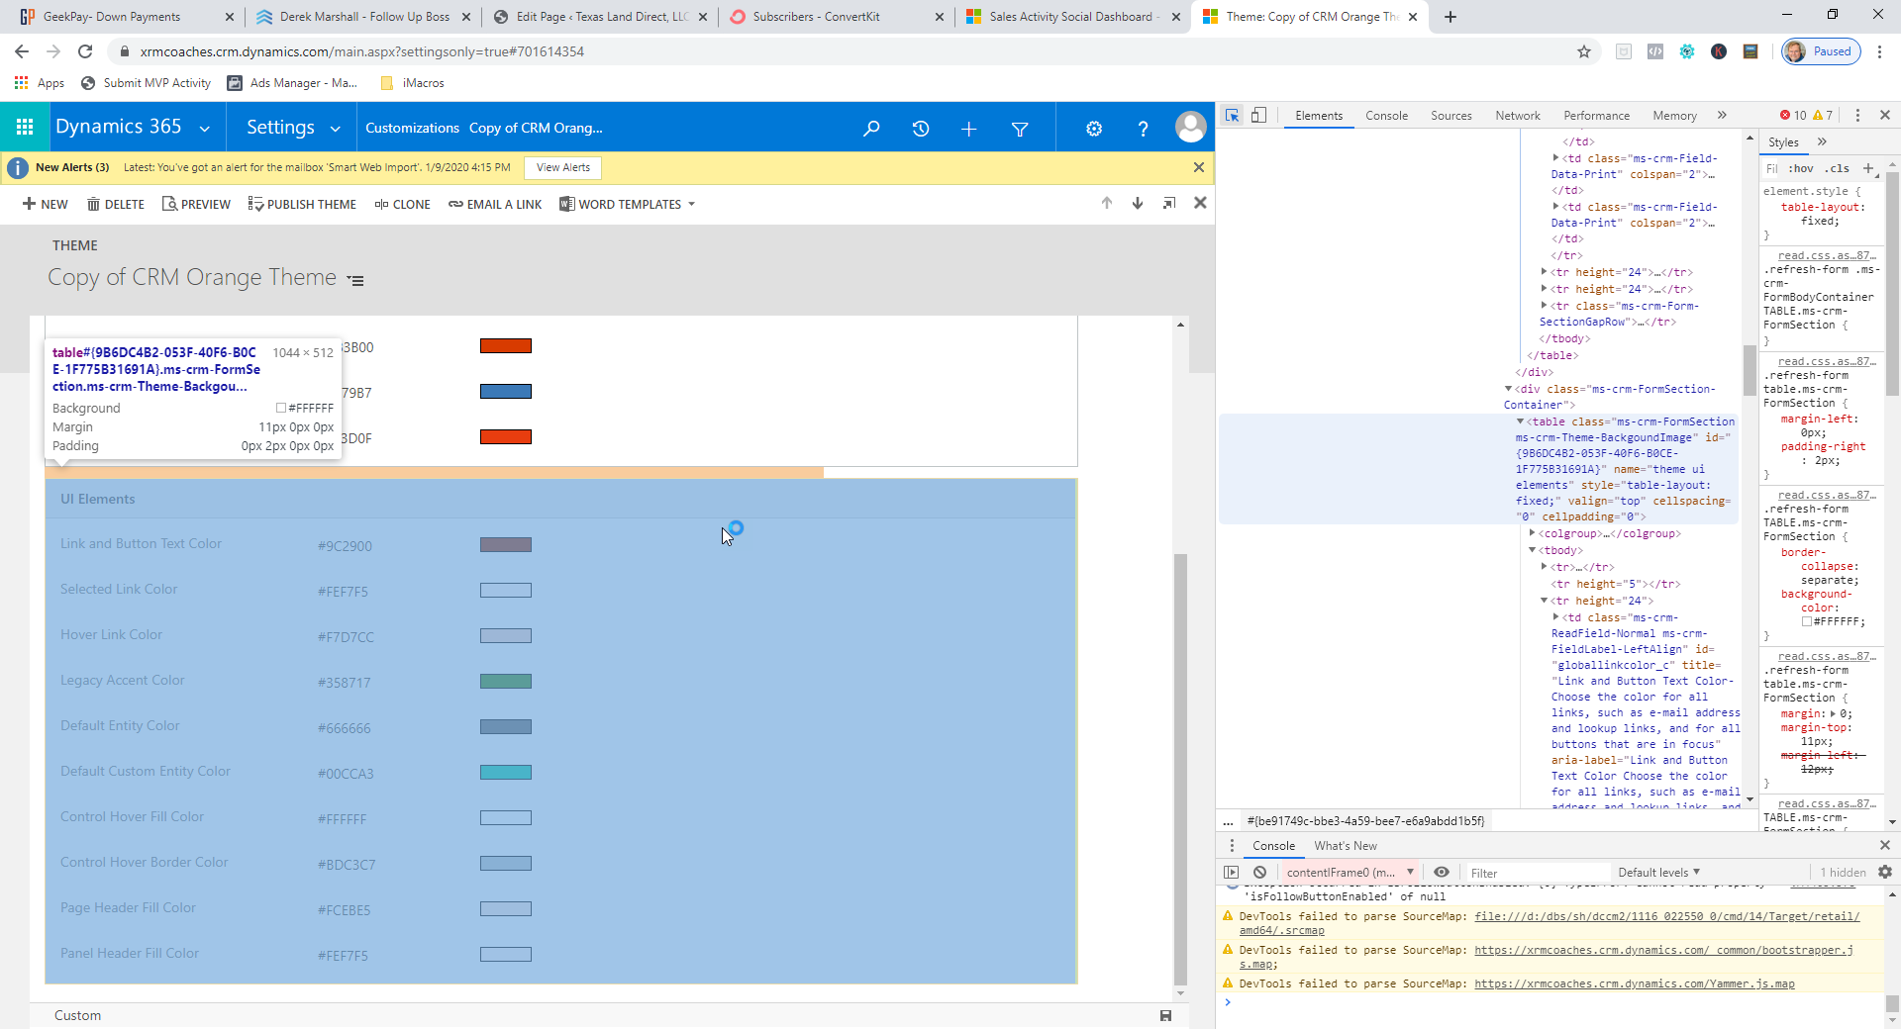
Capturing HTML Using Chrome

Slide 22
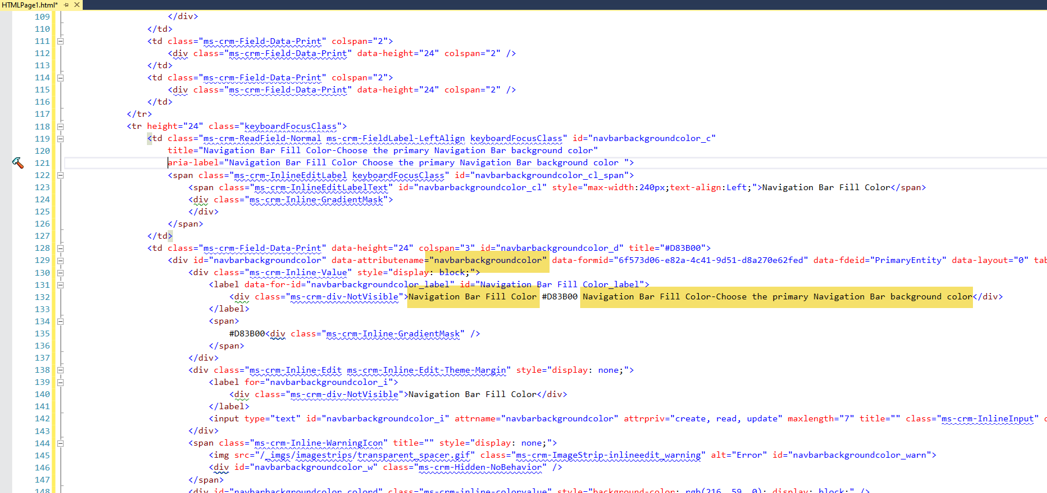
HTML Data Extraction

Slide 23
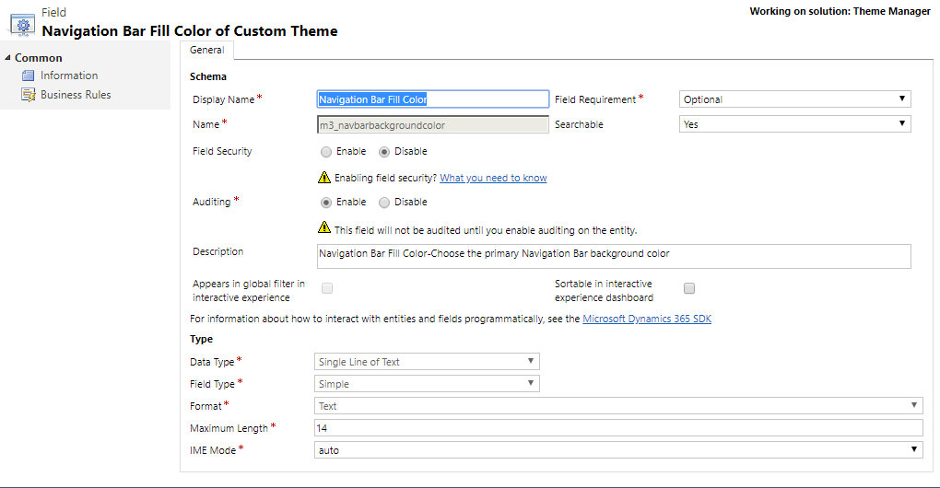
Field Creation

Slide 24
User Interface Design
…

Slide 25
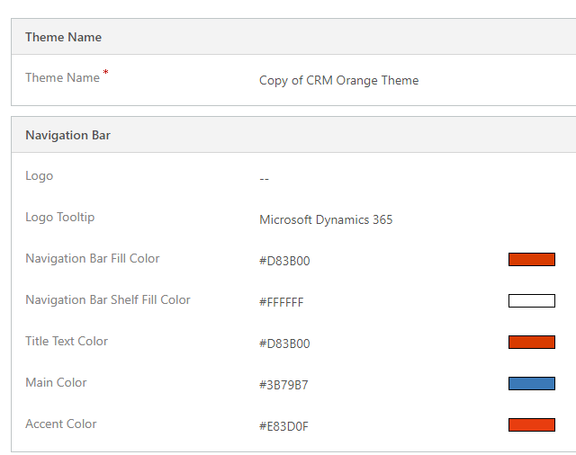
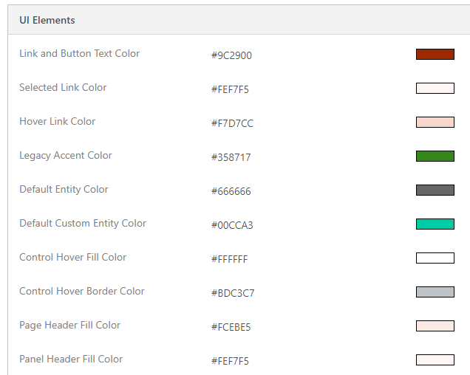
Built-In Theme Designer

Slide 26
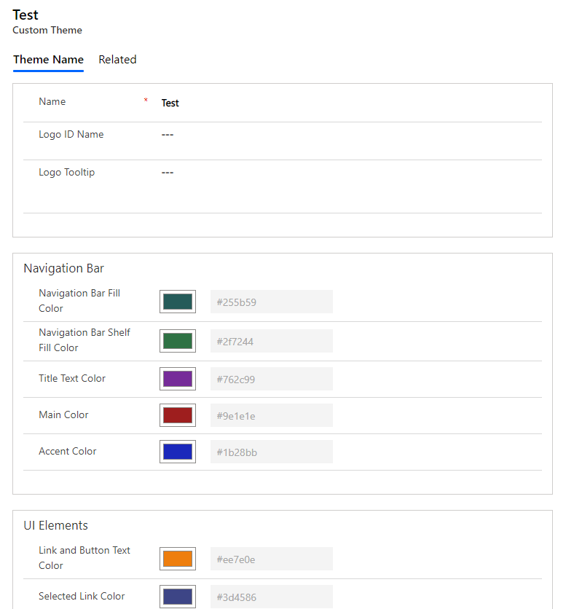
Theme Generator

Slide 27
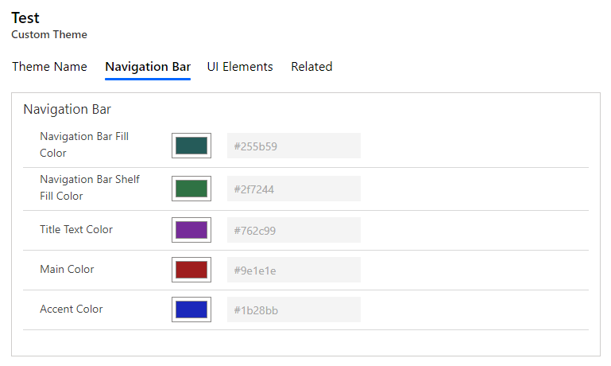
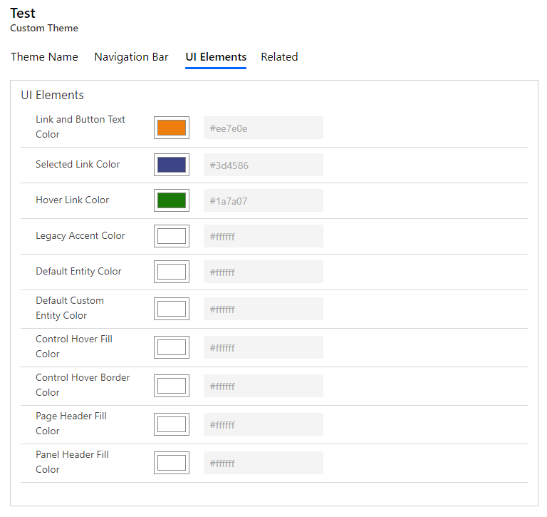
Revision 1

Slide 28
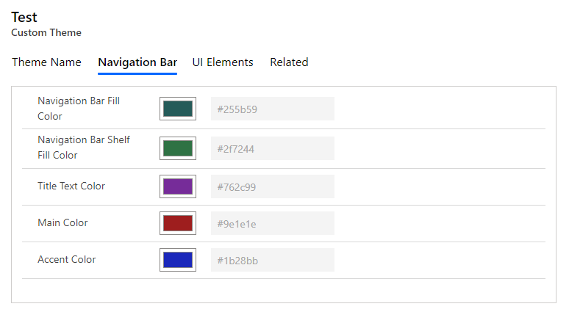
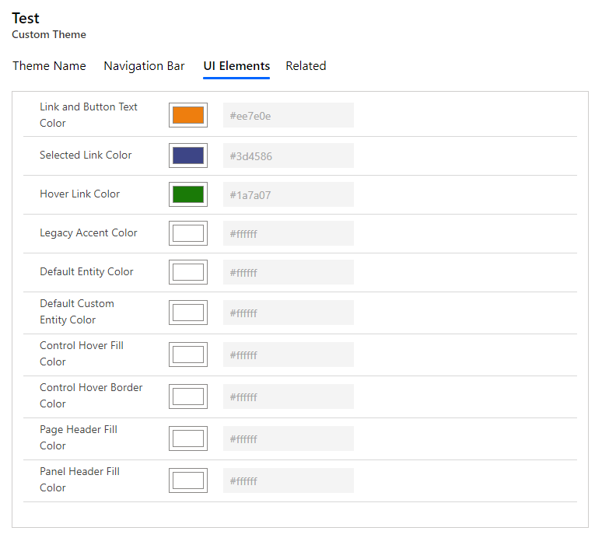
Revision 2

Slide 29
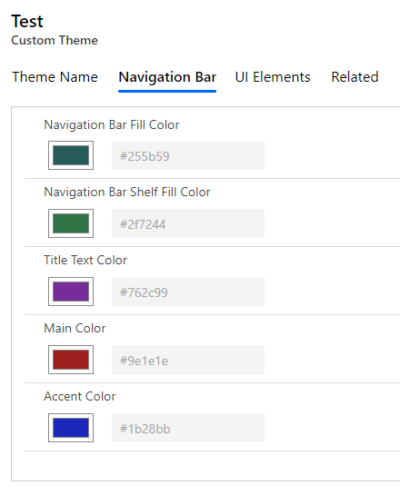
Revision 3

Slide 30
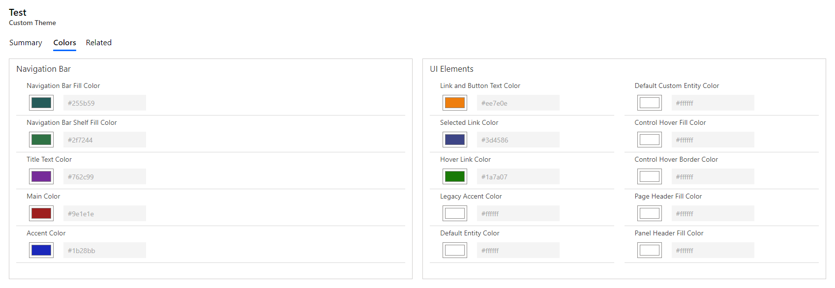
Revision 4

Slide 31
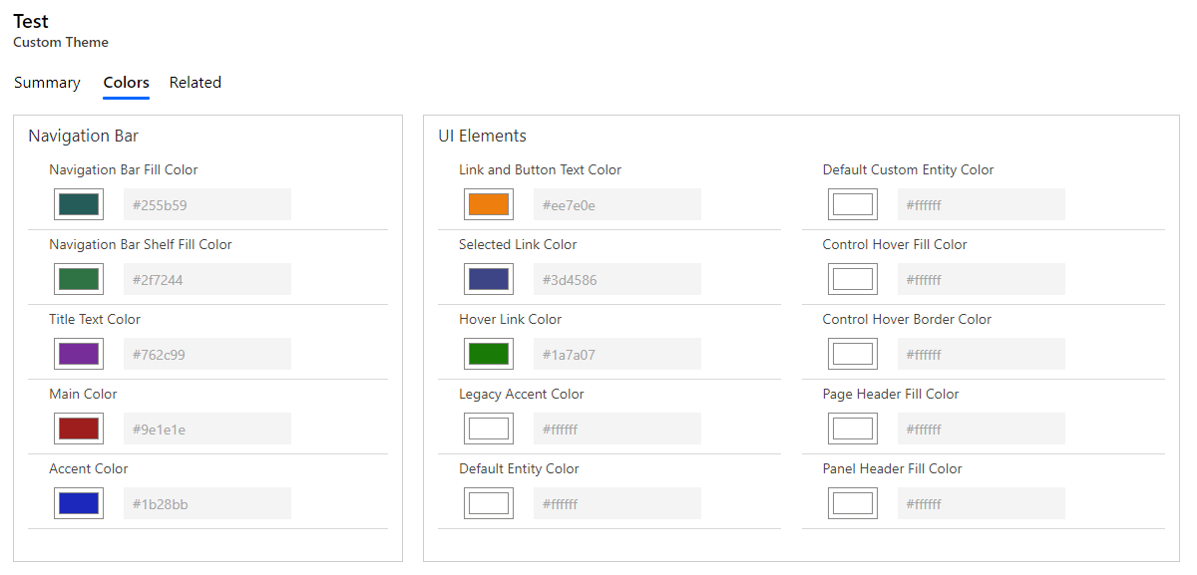
Revision 5 - Final

Slide 32
Database Operations
…

Slide 33
Process
Theme Generator
Built-In Theme

Slide 34
Considerations
Do I build for the current iteration or future iterations
What skill set are required to produce the solution?
What is the ROI of each option?
Deployment requirements

Slide 35
Database Processes
Create and/or Update built-in Themes
If built-in Theme is updated, updated an associated Theme Generator record
There is no way to provide a lookup relationship to a built-in Theme
Data will need to be programmatically matched

Slide 36
Options
JavaScript
Plugin
Power Automate
Workflow

Slide 37
Questions?

Slide 38
Thank You

